Slide 1
Study suggestion:
1 year data from May 2021 to May 2022
Many system interruptions starting May 22 for measurements.
Only ~3.5 months of Rotating Albedometer (Method 3) data. Could use all the way to August
Select also sets of 3 days between Feb. 22 to May 22 to look closer at the comparison for ALL methods for ‘capacity testing’
Choose 1 set of nice clear sky days, and 1 set that has funky snow.
Notes:
Doing 3 days or doing 1 year is the same for most softwares; we run the full year and then single out into the chosen 3 day sets for plots or analysis.
More data: better bias reduction, but more RMSE.
Technically ~3 years of data available for 2 bifacial rows, and 1 monofacial string level comparison.
Nov. 2020 one extra bifacial row added (total of 3 bifacial rows open data available)
Spectrum Responsivity effects and ‘location’ of sensors effects can be evaluated and interpreted as ‘uncertainty’ for all the variations of methods.

Slide 2
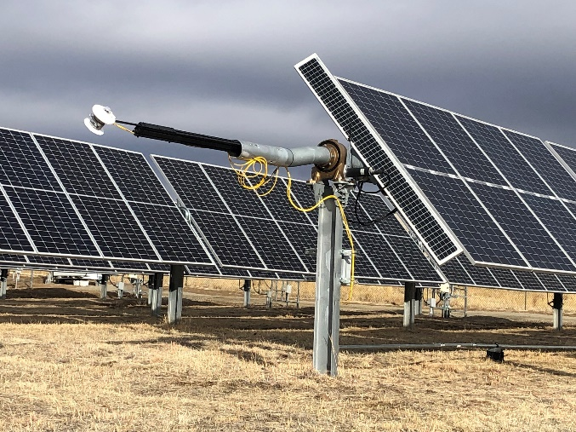
Methods Summary
Baseline – DNI and DHI, Perez model to Performance with T correction Kings Model, CM11 albedometer
1 – From Weather to Performance, with Albedometer data
2 – From POA (front or front+rear) to Performance
3 – Unobstructed Rotating Albedometer
4 – Reference Module

Slide 3
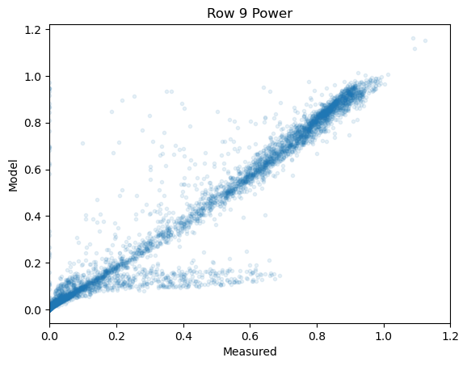
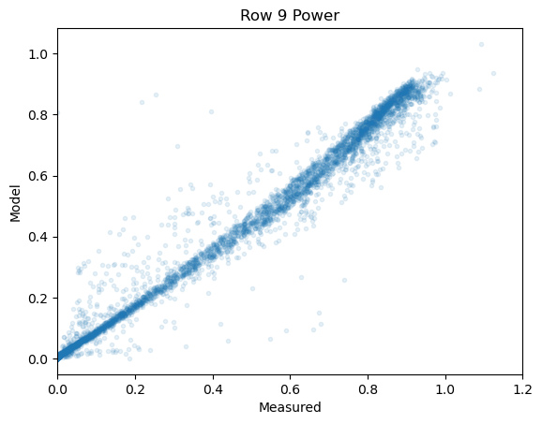
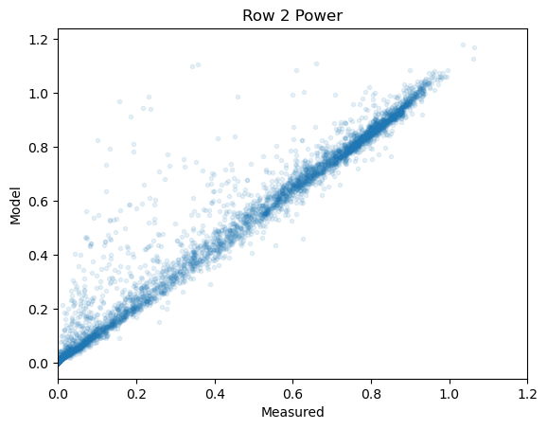
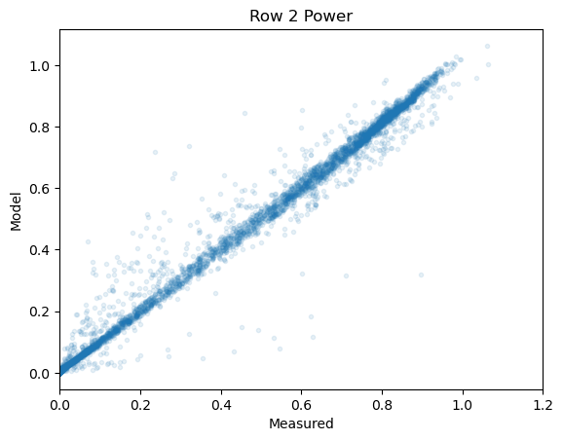
Method 1
Method 2
Modeling from measured
DNI and DHI
Modeling from measured
POA

Slide 4
Overview Sims
GREY Cells: Averages
Red text: Ref Cells and broadband
Blue text: Broadbands
Black text: Ref Cells
Method | Sim | Weather File | Theme | Main Variation:
1 | 00 | 00 | baseline
1 | A01 | A01 | Test Albedo | 1 - sunkitty_albedo_CM22
1 | A02 | A02 |  | 2 - sunkitty_albedo_IMT
1 | A03 | A03 |  | 3 - sunkitty_albedo_AP
1 | A04 | A04 |  | 4 - SRRL_albedo
1 | W01 | W01 | Test Wind Speed | 1 - row2wind_speed
1 | W02 | W02 |  | 2 - rowFieldWindSpeedAverage
1 | W03 | W03 |  | 3 - SRRL_windspeed
1 | T01 | T01 | Test Temperature | 1 - row2temperature_ambient
1 | T02 | T02 |  | 2 - row5temperature_ambient
1 | T03 | T03 |  | 3 - SRRL_temperature_ambient
1 | T04 | T04 |  | 4 - Back of Module Temperature
1 | S01 | 00 | Source Irradiance and Sky Model Test | DNI + GHI with Perez
1 | S02 | 00 |  | GHI + DHI with Perez
1 | S03 | 00 |  | DNI + DHI with Isotropic
1 | S04 | 00 |  | DNI + DHI with HDKR
1 | S05 | 00 |  | DNI + GHI with HDKR
1 | S07 | 00 |  | GHI + DHI with HDKR

Slide 5
Overview Sims
GREY Cells: Averages
Red text: Ref Cells and broadband
Blue text: Broadbands
Black text: Ref Cells
Method | Sim | Weather File | Theme | POA
2 | P00 | P00 | POA Ref | 0 - row3Gfront
2 | P01 | P01 |  | 1 - rowGfront_IMT_Average
2 | P02 | P02 |  | 2 - row2Gfront
2 | P03 | P03 |  | 5 - row5Gfront
2 | P04 | P04 |  | 6 - row7Gfront
2 | P05 | P05 |  | 8 - row9Gfront
2 | P06 | P06 |  | 9 - rowGfront_ALL_Averages
2 | P07 | P07 | POA Pyr | 3 - row3Gfront_CM11
2 | P08 | P08 |  | 4 - row3Gfront_Licor
2 | P09 | P09 |  | 9 - rowGfront_ALL_Averages
2 | P09 | P09 |  | 10 - rowGfront_Broadband_Averages
3 | P10 | P10 | POA Pyr Method 3 | 7 - row7RotatingAlbedometer_CM11_Up

Slide 6
Overview Sims
GREY Cells: Averages
Red text: Ref Cells and broadband
Blue text: Broadbands
Black text: Ref Cells
Method | Sim | Weather File | Theme | POA | BOA
2 | PB00 | PB00 | POA BOA Ref | 0 - row3Gfront | 0 - row3Grear_IMT_Averages
2 | PB01 | PB01 |  | 0 - row3Gfront | 1 - row3Grear_IMT_West
2 | PB02 | PB02 |  | 0 - row3Gfront | '2 - row3Grear_IMT_CenterWest
2 | PB03 | PB03 |  | 0 - row3Gfront | 3 - row3Grear_IMT_CenterEast
2 | PB04 | PB04 |  | 0 - row3Gfront | 4 - row3Grear_IMT_East
2 | PB05 | PB05 |  | 0 - row3Gfront | 8 - row5Grear
 |  |  |  | 0 - row3Gfront | 9 - row7Grear
2 | PB06 | PB06 |  | 0 | 9
2 | PB07 | PB07 |  | 0 - row3Gfront | 10 - row7Grear_IMT_CenterEast
2 | PB08 | PB08 |  | 0 - row3Gfront | 11 - row7Grear_IMT_East
2 | PB09 | PB09 |  | 0 - row3Gfront | 13 - row9Grear
2 | PB10 | PB10 |  | 0 - row3Gfront | 14 - rowGrear_IMT_Averages
2 | PB11 | PB11 |  | 0 - row3Gfront | 15 - rowGrear_ALL_Averages
2 | PB12 | PB12 |  | 9 - rowGfront_ALL_Averages | 15 - rowGrear_ALL_Averages
2 | PB13 | PB13 | POA BOA Pyr | 10 - rowGfront_Broadband_Averages | 5 - row3Grear_CM11
2 | PB14 | PB14 |  | 10 - rowGfront_Broadband_Averages | 6 - row3Grear_Licor
2 | PB15 | PB15 |  | 10 - rowGfront_Broadband_Averages | 15 - rowGrear_ALL_Averages
2 | PB16 | PB16 |  | 10 - rowGfront_Broadband_Averages | 16 - rowGrear_Broadband_Averages
3 | PB17 | PB17 | POA BOA Pyr Method 3 | 10 - rowGfront_Broadband_Averages | 12 - row7RotatingAlbedometer_CM11_Down
3 | PB18 | PB18 |  | 7 - row7RotatingAlbedometer_CM11_Up | 12 - row7RotatingAlbedometer_CM11_Down

Slide 7
Monofacial
-~6-10% MBD – Sandia said it should be 2-3%
-Wind no effect
-Albedo and sky model offer the most variability to performance.
ADD METHOD 2 HERE
Bifacial Longi
Bifacial SHJ Sunpreme
Uncertainty
Of Sensor itself
Uncertainty
Of MEASURED
Data

Slide 8
How to consider the uncertainty of the sensor itself?
Ditter the sensor based on the uncertainty profile of the sensor
(or if square then +-2%, run +% and -2%
Modify the input data

Slide 9
CHEcK if 0s (night) are included?
-Wind no effect
-Albedo and sky model offer the most variability to performance.
T – temp, W – wind, S – source, A - Albedo
MAYBE Do one for Clear Sky ?
Or Filter Low irrad values
ADD Median
Add Uncertainty for Ref Cell
Add Uncertainty for Pyr CM11
3%~ Calibration Accuracy + hourly basis and clear sky + …
Notes:
instrumental uncertainty of sensor for global quantities are similar to instrumental uncertianties for POA quantities so the differnece between two methods come to the sky modeling
First principles basis conclusion that closer to right answer by measuring at POA.

Slide 10
Measured
ADD Median
Add Uncertainty for Ref Cell
Add Uncertainty for Pyr CM11

Slide 11

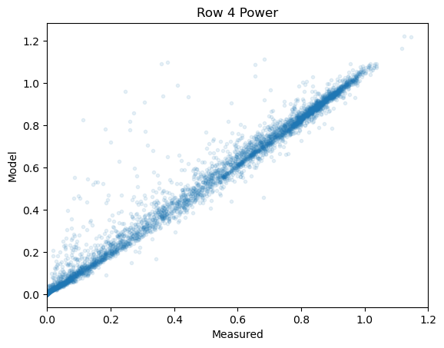
SIM 00

Slide 12
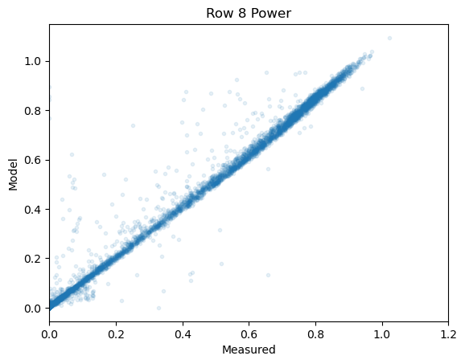
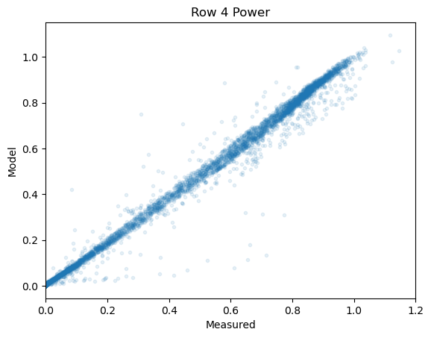
SIM P00

Slide 13
RMSE →
Max MBD – Min MBD for a cat.
i.e. range of model bias by changing the temperature

